Slide 1
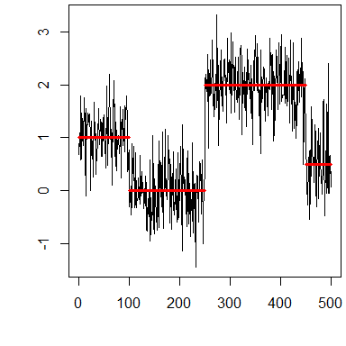
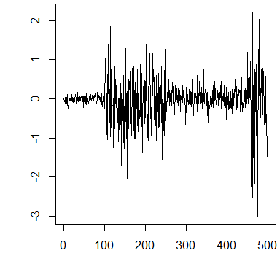
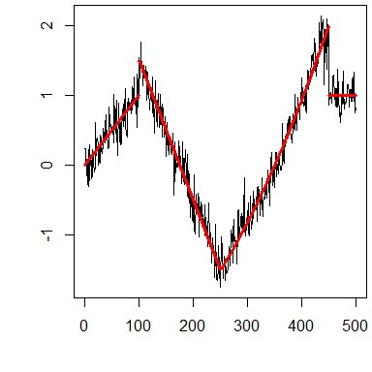
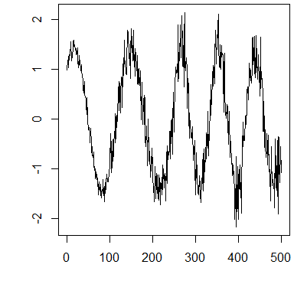
Introduction to Changepoint Analysis

Slide 2
References
Video Tutorials:
NHS-R Community Conference 2020. Introduction to changepoint analysis
https://www.youtube.com/watch?v=WelmlZK5G2Y
useR! International R User 2017 Conference Introduction to optimal changepoint detection algorithms
https://www.youtube.com/watch?v=I7jUBro78RM
Git-Repos for the tutorials
https://github.com/tdhock/change-tutorial
https://github.com/rkillick/intro-changepoint-course

Slide 3
Outline
What are changepoints?
Notation
Likelihood based changepoints
Change in mean
Change in variance
Change in mean & variance
How many changes?
Non-parametric changepoints
Checking assumptions

Slide 4
What are Changepoints?
Changepoints are also known as:
breakpoints
segmentation
structural breaks
regime switching
detecting disorder
and can be found in a wide range of literature including
quality control
economics
medicine
environment
linguistics

Slide 5
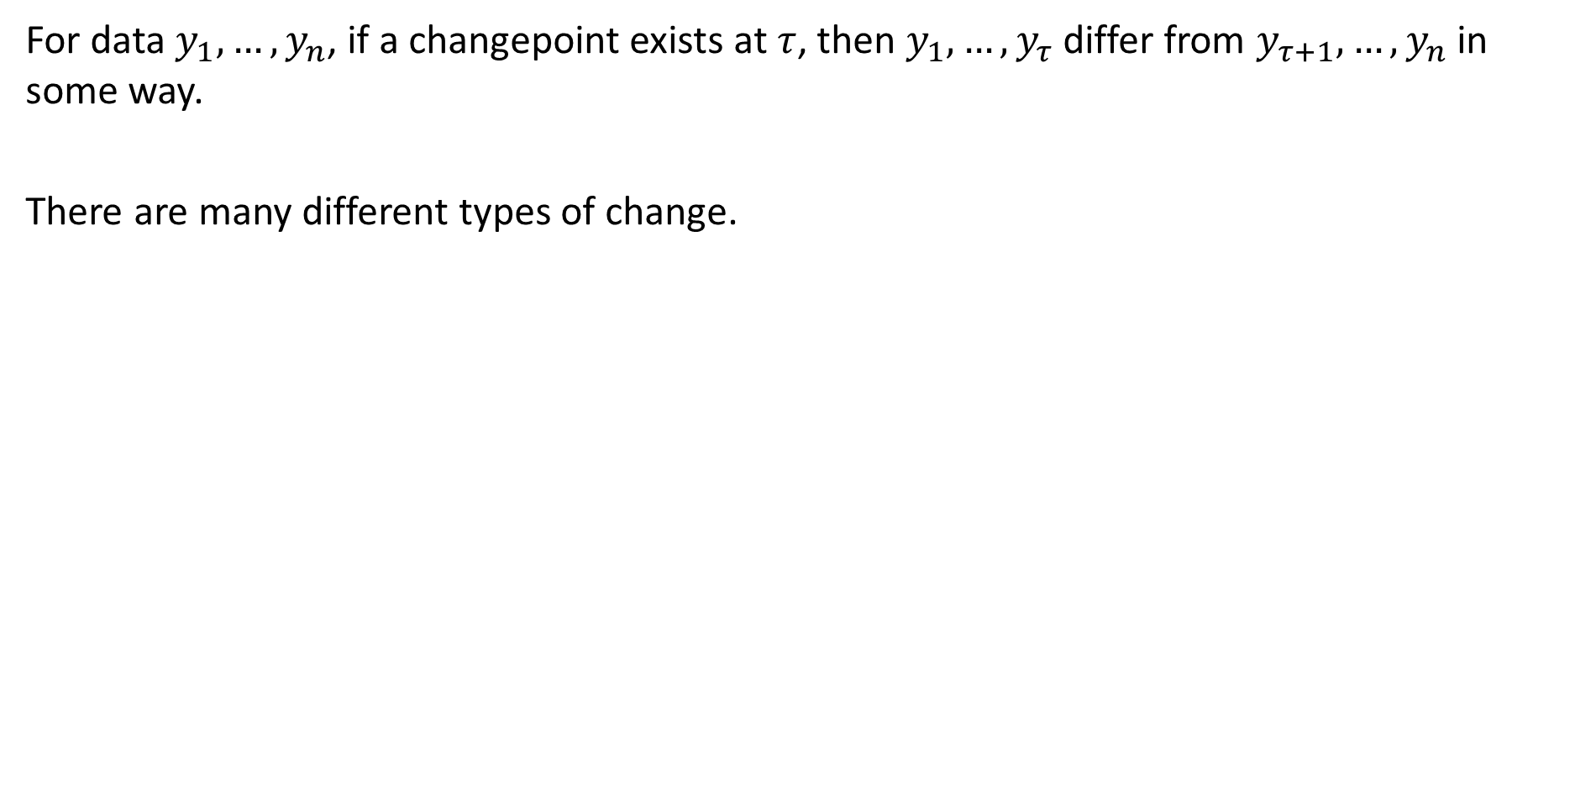
What are changepoints?
For data $y_{1},…,y_{n}$, if a changepoint exists at $τ$, then $y_{1},…,y_{τ}$ differ from $y_{τ+1},…,y_{n}$ in some way.
There are many different types of change.

Slide 6
What is the goal?
Has a change occurred?
If yes, where is the change?
What is the difference between the pre and post change data?
Maybe this is the type of change
Maybe it is the parameter values before and after the change
What is the probability that a change has occured?
How certain are we of the changepoint location?
How many changes have occurred (+ all the above for each change)?
Why has there been a change?

Slide 7
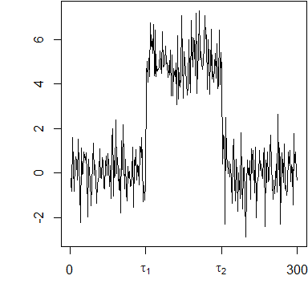
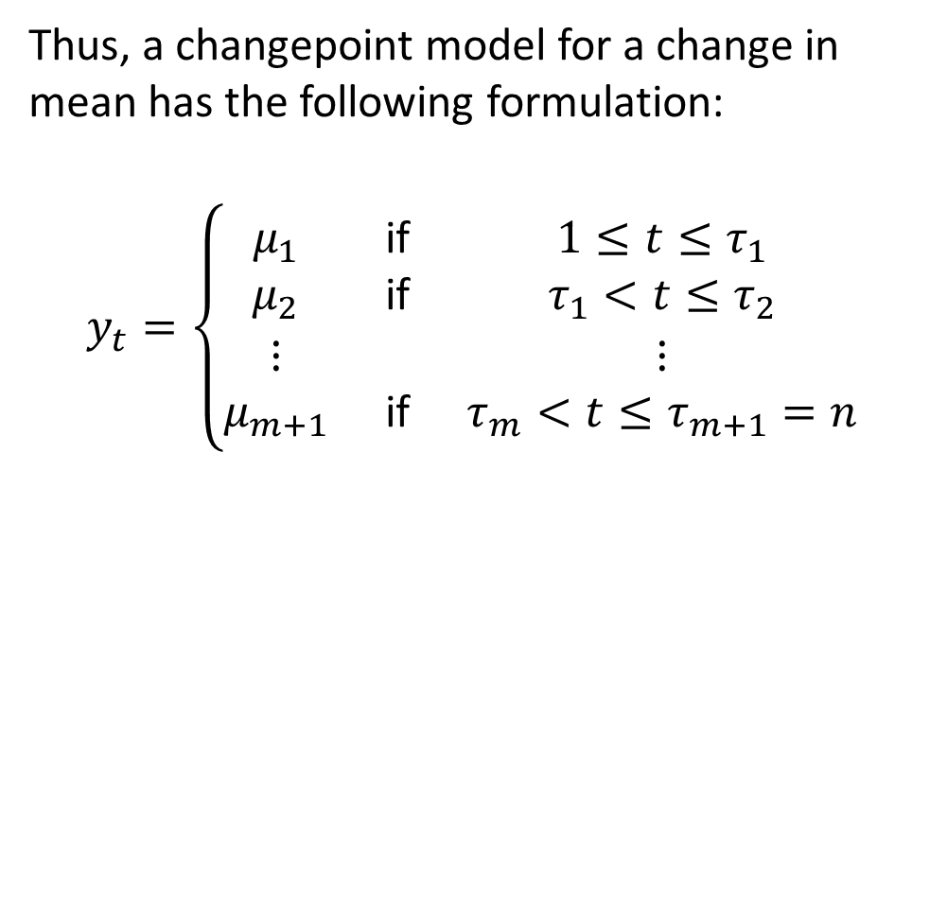
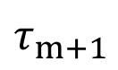
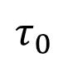
Notation and Concepts
Thus, a changepoint model for a change in mean has the following formulation:
$$y_{t}=\left\{\begin{matrix}μ_{1} & \text{if} & 1≤t≤τ_{1} \\ μ_{2} & \text{if} & τ_{1}<t≤τ_{2} \\ ⋮ & & ⋮ \\ μ_{m+1} & \text{if} & τ_{m}<t≤τ_{m+1}=n\end{matrix}\right.$$
$$τ_{0}$$
$$τ_{m+1}$$

Slide 8
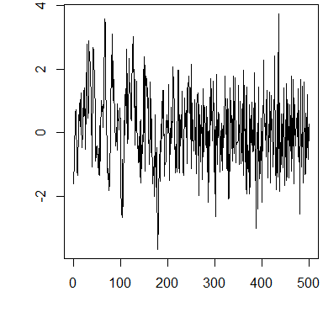
More complicated changes

Slide 9
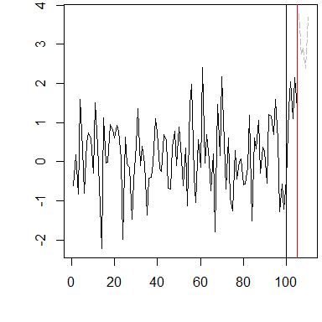
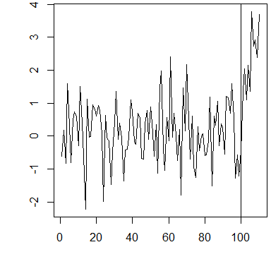
Online vs Offline
Online
Processes data as it arrives or in batches
Goal is quickest detection of a change
Often used in processing control, intrusion detection
Offline
Processes all the data in one go
Goal is accurate detection of a change
Often used in genome analysis, audiology

Slide 10
Packages
Today we will use the
library(changepoint)
library(changepoint.np)
packages.
Other notable R packages are available for changepoint analysis including
strucchange - for changes in regression
bcp - if you want to be Bayesian
cpm - for online changes (changepoint.online coming soon)
EnvCpt - for testing between changes in mean, trend and/or AR(1) structure

Slide 11
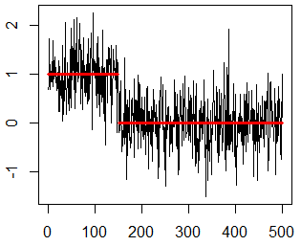
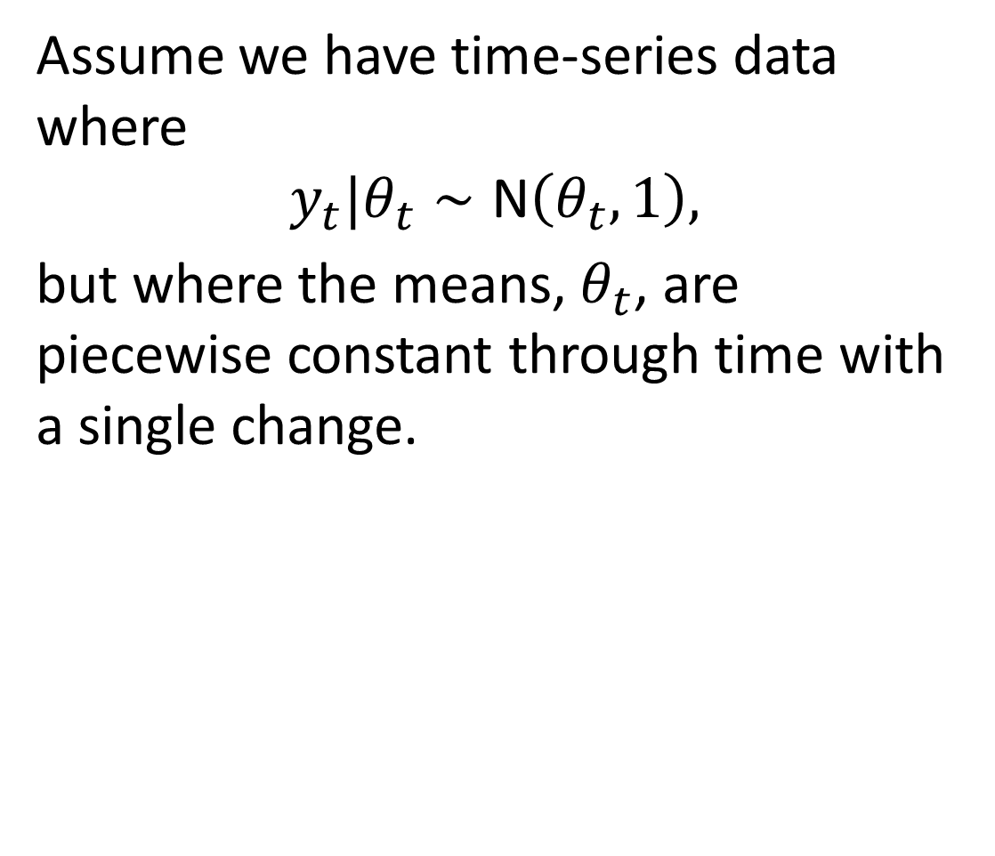
Single Changepoint
Assume we have time-series data where
$$y_{t}|θ_{t}∼\text{N}\left(θ_{t},1\right),$$
but where the means, $θ_{t}$, are piecewise constant through time with a single change.

Slide 12
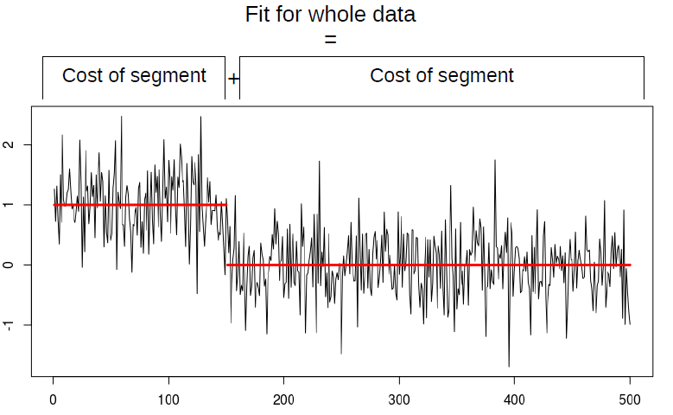
Single Changepoint
(optional)
- Cost of Whole

Slide 13
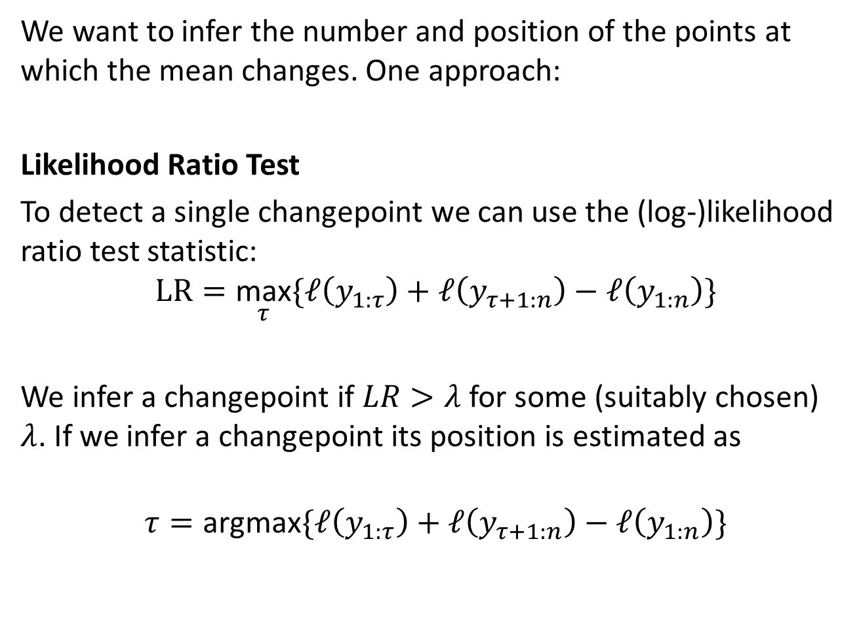
Single Changepoint
We want to infer the number and position of the points at which the mean changes. One approach:
Likelihood Ratio Test
To detect a single changepoint we can use the (log-)likelihood ratio test statistic:
$$LR=\underset{τ}{\text{max}}\{ℓ\left(y_{1:τ}\right)+ℓ\left(y_{τ+1:n}\right)−ℓ\left(y_{1:n}\right)\}$$
We infer a changepoint if $LR>λ$ for some (suitably chosen) $λ$. If we infer a changepoint its position is estimated as
$$τ=\text{argmax}\{ℓ\left(y_{1:τ}\right)+ℓ\left(y_{τ+1:n}\right)−ℓ\left(y_{1:n}\right)\}$$

Slide 14
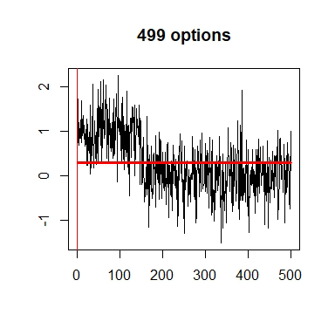
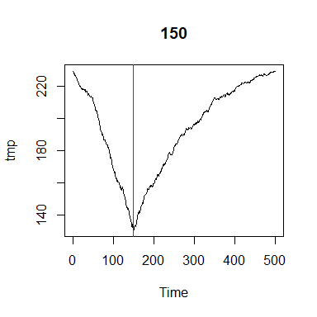
Finding a single change

Slide 15
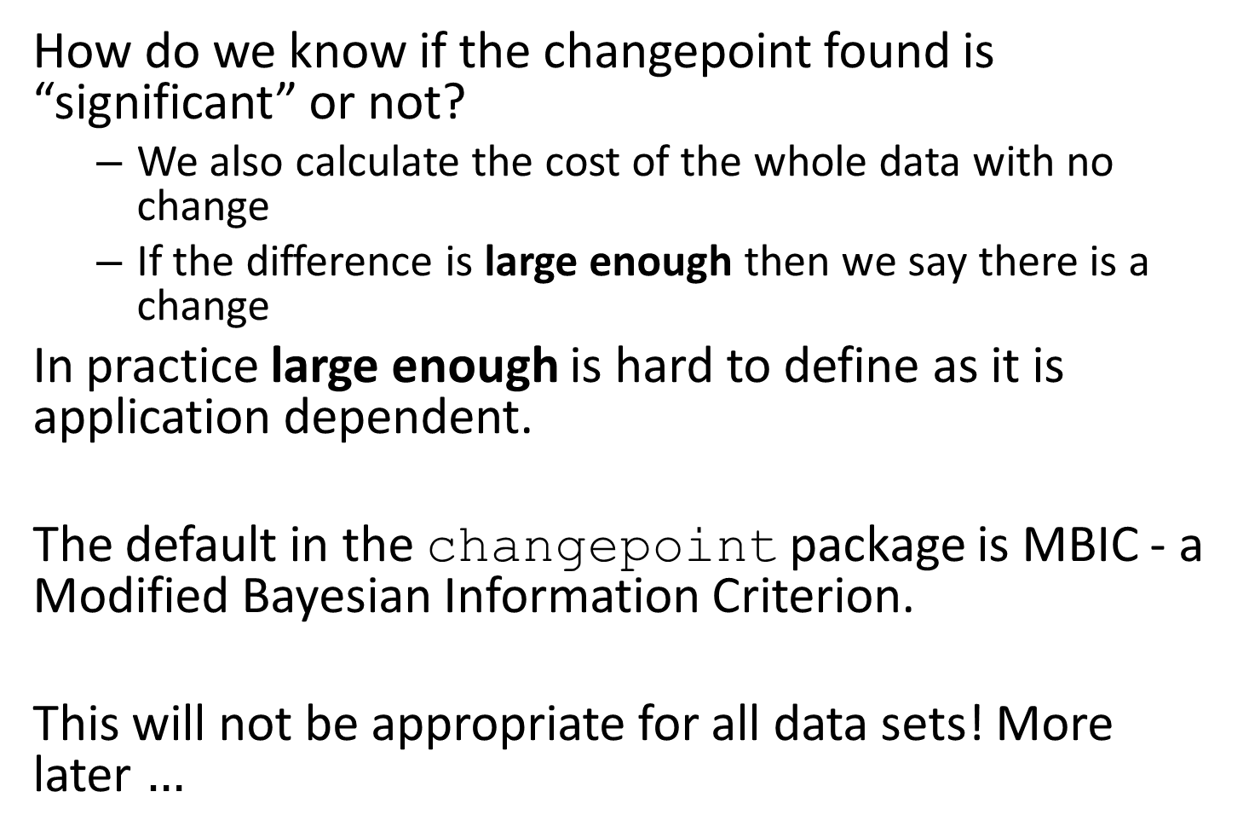
Finding a single change
How do we know if the changepoint found is “significant” or not?
We also calculate the cost of the whole data with no change
If the difference is large enough then we say there is a change
In practice large enough is hard to define as it is application dependent.
The default in the changepoint package is MBIC - a Modified Bayesian Information Criterion.
This will not be appropriate for all data sets! More later $…$

Slide 16
changepoint R package
The changepoint R package contains 3 wrapper functions:
cpt.mean - mean only changes
cpt.var - variance only changes
cpt.meanvar - mean and variance changes
The package also contains:
functions/methods for the cpt S4 class
5 data sets
other R functions that are made available for those who know what they are doing and might want to extend/modify the package.

Slide 17
The cpt class
S4 class
Slots store all the information from the analysis
e.g. data.set, cpts, param.est, pen.value, ncpts.max
Slots are accessed via their names e.g. cpts(x)
Standard methods are available for the class e.g. plot, summary
Additional generic functions are available e.g. seg.len, ncpts
Each core function outputs a cpt object

Slide 18
cpt.mean
cpt.mean(data, penalty="MBIC", pen.value=0, method="AMOC", Q=5, test.stat="Normal", class=TRUE, param.estimates=TRUE,minseglen=1)
data - vector or ts object
penalty - cut-off point, MBIC, SIC, BIC, AIC, Hannan-Quinn, Asymptotic, Manual.
pen.value - Type I error for Asymptotic, number or character for manual.
method - AMOC, PELT, SegNeigh, BinSeg.
Q - max number of changes for SegNeigh or BinSeg.
test.stat - Test statistic/distribution of the data, Normal or CUSUM.
class - return a cpt object or not.
param.estimates - return parameter estimates or not.
minseglen - minimum number of data points between changes.

Slide 19
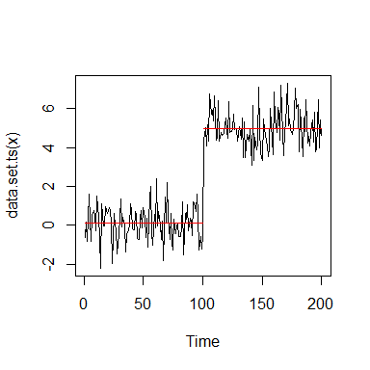
Single Change in Mean
IMPORTANT: The cpt.mean function assumes that the variance of a time series is 1. If this is not the case then you need to scale the data prior to analysis.
set.seed(1) m1=c(rnorm(100,0,1),rnorm(100,5,1)) m1.amoc=cpt.mean(m1) cpts(m1.amoc)
## [1] 100
plot(m1.amoc)

Slide 20
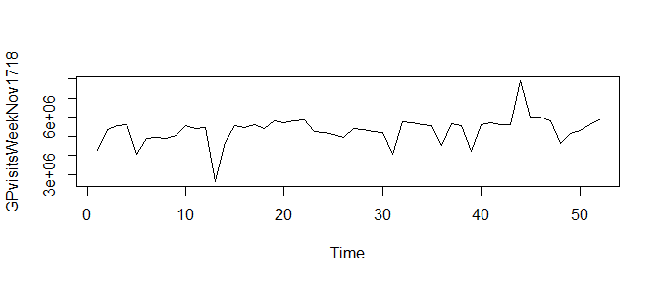
Task: GP Weekly Appts.
Data from NHS Digital, weekly number of appointments (for all types) between Nov 2017 and Oct 2018.
load('GPvisitsWeekNov1718.Rdata') ts.plot(GPvisitsWeekNov1718)
Is there a change?

Slide 21
Task: GP Weekly Appts.
Use the cpt.mean function to see if there is evidence for a change in mean in the weekly GP appointment data.
load('GPvisitsWeekNov1718.Rdata')
If you identify a change, where is it and what are the pre and post change means?
Don’t forget to
library(changepoint)
before you start

Slide 22
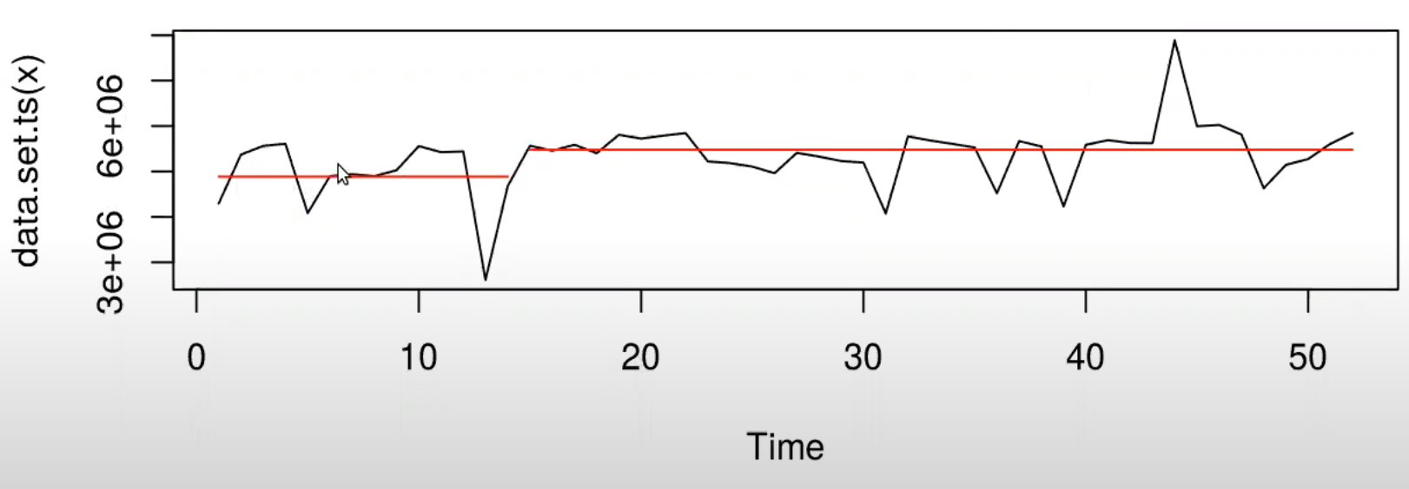
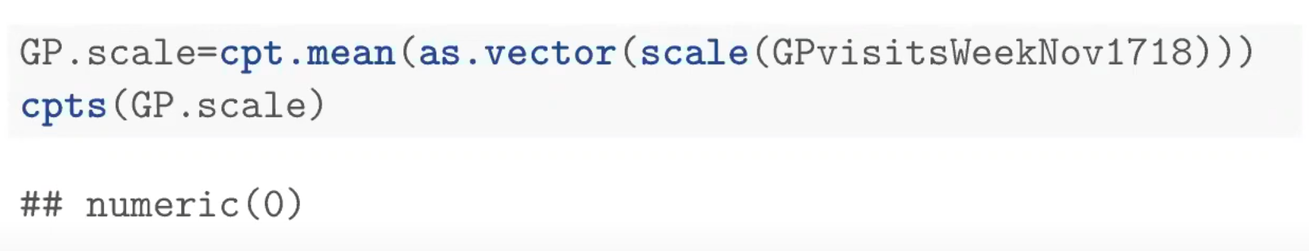
Task: GP Weekly Appts.
Does it has the variance of 1?

Slide 23
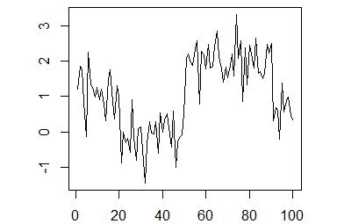
Multiple Changepoints

Slide 24
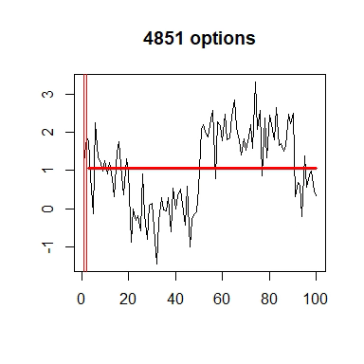

Multiple Changepoints
What are the values of $τ_{1},…,τ_{m}$?
What is $m$?
For $n$ data points there are $2^{n−1}$ possible solutions
If $m$ is known there are still $\left({n−1 \atop m}\right)$ solutions
If $n=1000$ and $m=10$, $2.607755×{10}^{23}$ solutions
How do we search the solution space efficiently?

Slide 25
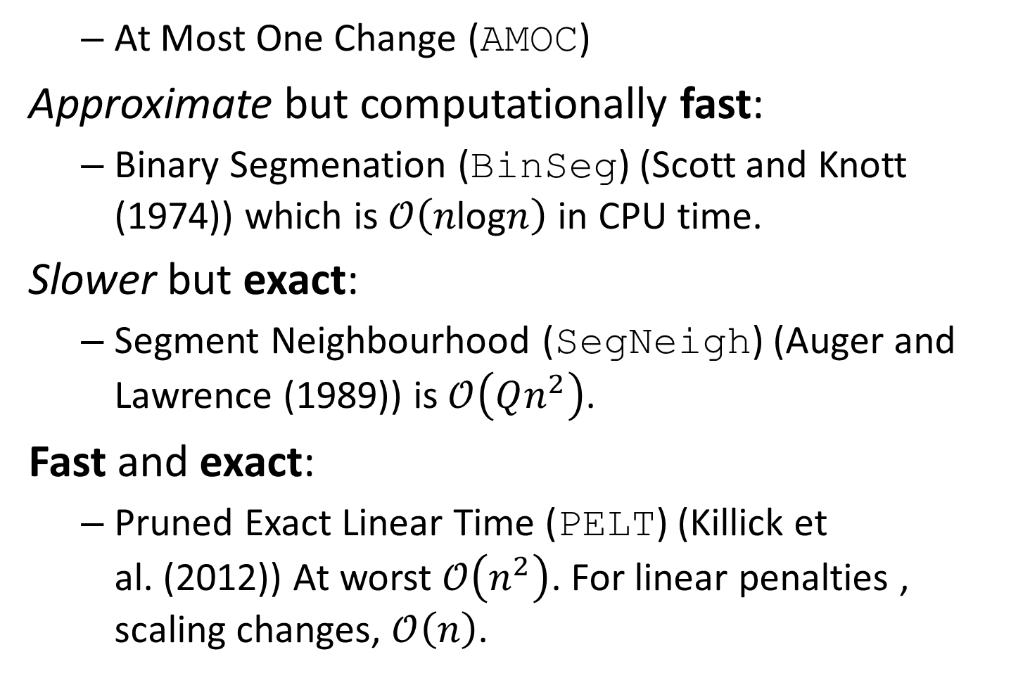
Methods in changepoint
At Most One Change (AMOC)
Approximate but computationally fast:
Binary Segmenation (BinSeg) (Scott and Knott (1974)) which is $𝒪\left(n\text{log}n\right)$ in CPU time.
Slower but exact:
Segment Neighbourhood (SegNeigh) (Auger and Lawrence (1989)) is $𝒪\left(Qn^{2}\right)$.
Fast and exact:
Pruned Exact Linear Time (PELT) (Killick et al. (2012)) At worst $𝒪\left(n^{2}\right)$. For linear penalties , scaling changes, $𝒪\left(n\right)$.

Slide 26
cpt.var
cpt.var(data, penalty, pen.value, know.mean=FALSE, mu=NA, method, Q, test.stat="Normal", class, param.estimates, minseglen=2)
Majority of arguments are the same as for cpt.mean
know.mean - if known we don’t count it as an estimated parameter when calculating penalties.
mu - Mean if known.
test.stat - Normal or CSS (cumulative sums of squares)
minseglen - Default is 2

Slide 27
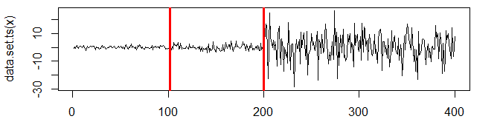
Changes in Variance
set.seed(1) v1=c(rnorm(100,0,1),rnorm(100,0,2),rnorm(100,0,10), rnorm(100,0,9)) v1.man=cpt.var(v1,method='PELT',penalty='Manual', pen.value='2*log(n)') cpts(v1.man) param.est(v1.man)
## [1] 102 200 ## $variance ## [1] 0.8007158 3.6933616 92.3876410 ## ## $mean ## [1] 0.1986058
Ratios of true variances (4, 25, 0.81)
plot(v1.man,cpt.width=3)
Notes:
Penalty is same as SIC=BIC

Slide 28
cpt.meanvar
cpt.meanvar(data, penalty, pen.value, method, Q, test.stat="Normal", class, param.estimates, shape=1,minseglen=2)
Again the same underlying structure as cpt.mean.
test.stat - choice of Normal, Gamma, Exponential, Poisson.
shape - assumed shape parameter for Gamma.
minseglen - minimum segment length of 2

Slide 29
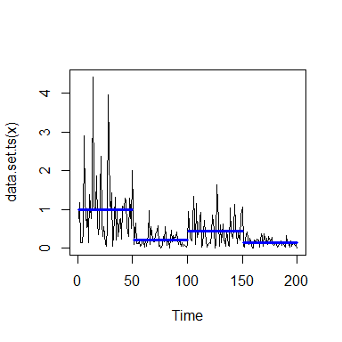
Mean & Variance
set.seed(1) mv1=c(rexp(50,rate=1),rexp(50,5),rexp(50,2),rexp(50,7)) mv1.pelt=cpt.meanvar(mv1,
test.stat='Exponential', method='BinSeg’,
Q=10,penalty="SIC") cpts(mv1.pelt)
## [1] 50 100 150
param.est(mv1.pelt)
## $rate ## [1] 1.016217 4.641184 2.235431 6.705612
plot(mv1.pelt,cpt.width=3,
cpt.col='blue')

Slide 30
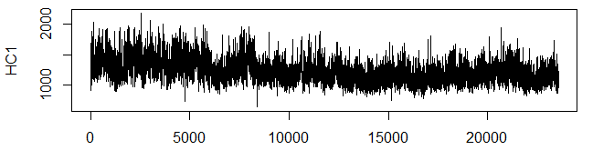
Task HC1
G+C content within part of Human Chromosome 1, data from NCBI. 3kb windows along the Human Chromosome from 10Mb to 33Mb.
Use the cpt.meanvar function to identify regions with different C+G content.
data(HC1) ts.plot(HC1)

Slide 31
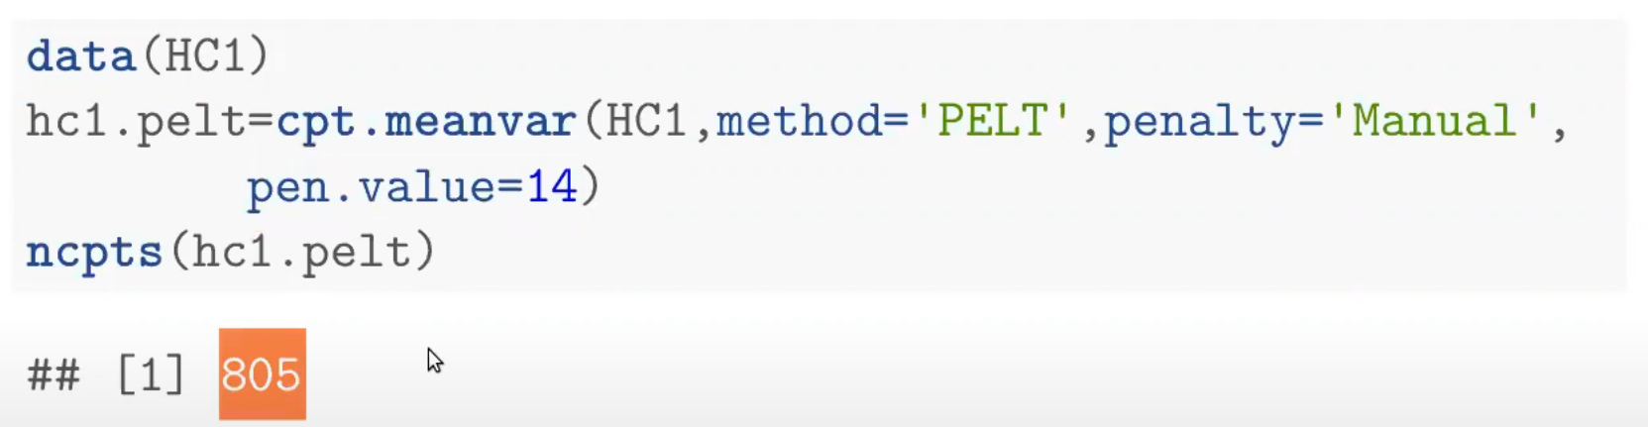
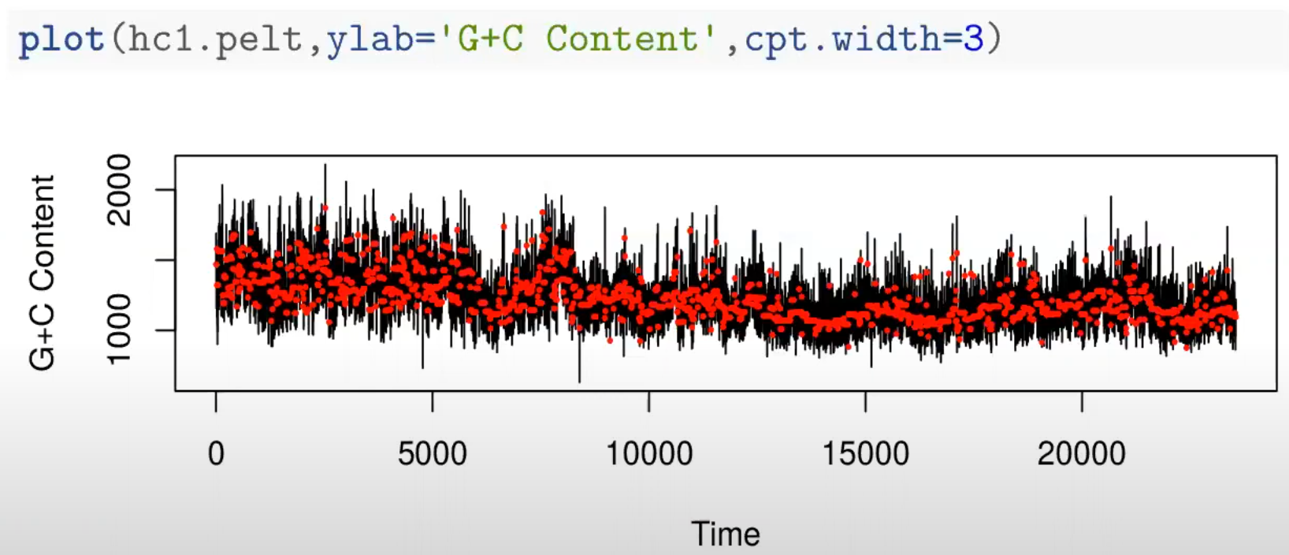
Task HC1

Slide 32
CROPS
Changepoints for a range of penalties
Use penalty='CROPS' with method='PELT' to get all segmentations for a range of penalty values.
v1.crops=cpt.var(v1,method="PELT",penalty="CROPS", pen.value=c(5,500))
## [1] "Maximum number of runs of algorithm = 10" ## [1] "Completed runs = 2" ## [1] "Completed runs = 3" ## [1] "Completed runs = 4" ## [1] "Completed runs = 5" ## [1] "Completed runs = 6" ## [1] "Completed runs = 8" ## [1] "Completed runs = 9"

Slide 33
CROPS
cpts.full(v1.crops)
## [,1] [,2] [,3] [,4] [,5] [,6] [,7] [,8] ## [1,] 102 114 133 201 206 213 375 379 ## [2,] 102 114 133 201 206 375 379 NA ## [3,] 102 114 133 201 206 NA NA NA ## [4,] 96 133 201 206 NA NA NA NA ## [5,] 102 201 206 NA NA NA NA NA ## [6,] 102 200 NA NA NA NA NA NA ## [7,] 200 NA NA NA NA NA NA NA ## [8,] NA NA NA NA NA NA NA NA

Slide 34
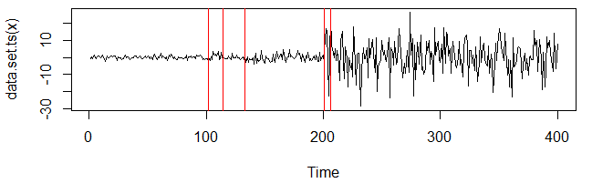
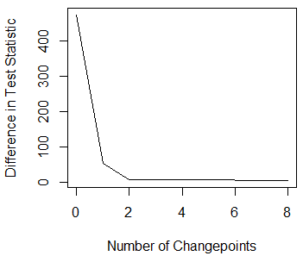
CROPS
pen.value.full(v1.crops)
## [1] 5.000000 5.431360 6.151053 6.270164 6.314013 6.526333 54.317625 ## [8] 474.797364
plot(v1.crops,ncpts=5)
“Scree” plot
plot(v1.crops,diagnostic=TRUE)

Slide 35
cpt.np
cpt.np(data, penalty, pen.value, method, test.stat="empirical_distribution", class, minseglen=1, nquantiles=10)
Again the same underlying structure as cpt.mean.
test.stat - choice of empirical_distribution
minseglen - minimum segment length of 1
nquantiles - number of quantiles to use

Slide 36
Example
set.seed(12) J <- function(x){(1+sign(x))/2} n <- 1000 tau <- c(0.1,0.13,0.15,0.23,0.25,0.4,0.44,0.65,0.76,0.78,0.81)*n h <- c(2.01, -2.51, 1.51, -2.01, 2.51, -2.11, 1.05, 2.16,-1.56, 2.56, -2.11) sigma <- 0.5 t <- seq(0,1,length.out = n) data <- array() for (i in 1:n){ data[i] <- sum(h*J(n*t[i] - tau)) + (sigma * rnorm(1)) }

Slide 37
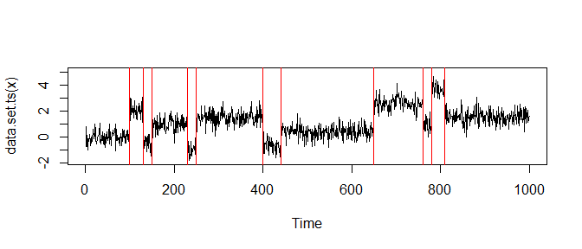
Example
out <- cpt.np(data, method="PELT",minseglen=2, nquantiles =4*log(length(data))) cpts(out)
## [1] 100 130 150 230 250 400 440 650 760 780 810
plot(out)

Slide 38
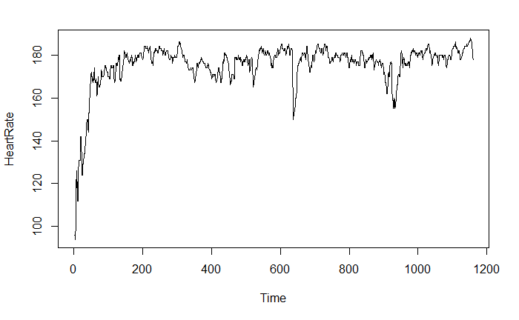
Task: cpt.np
Look at the HeartRate data from the changepoint.np package. Use one of the non-parametric functions to see if there is evidence for changes in heart rate.
data(HeartRate)

Slide 39
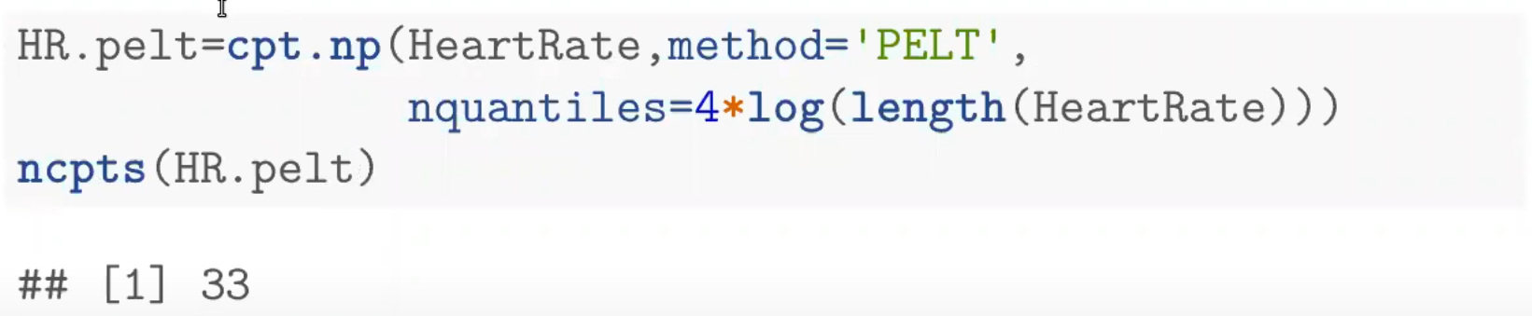
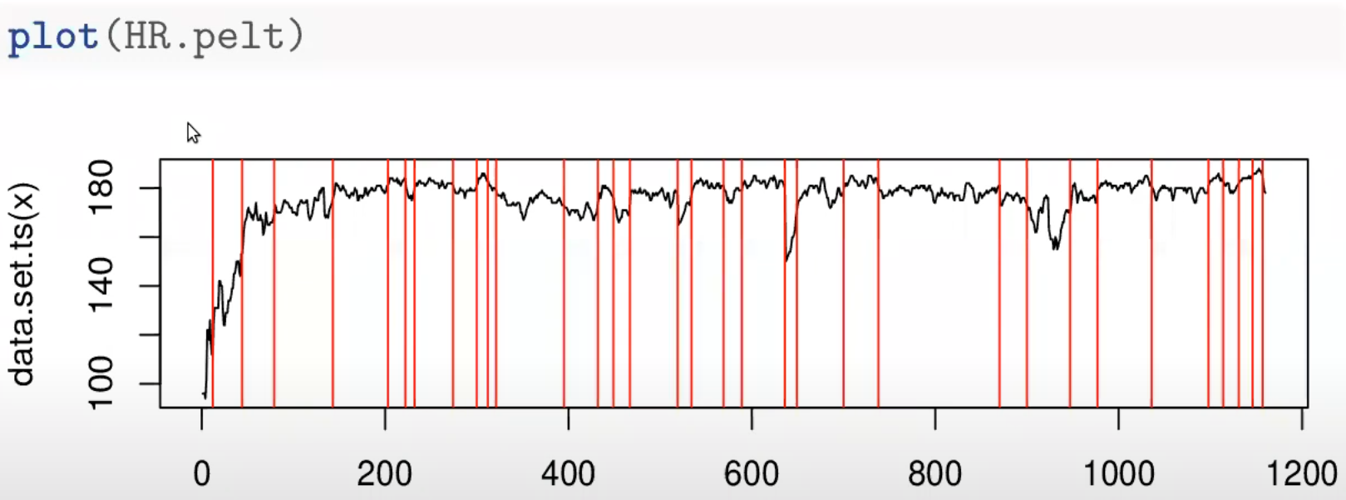
Task: HeartRate

Slide 40
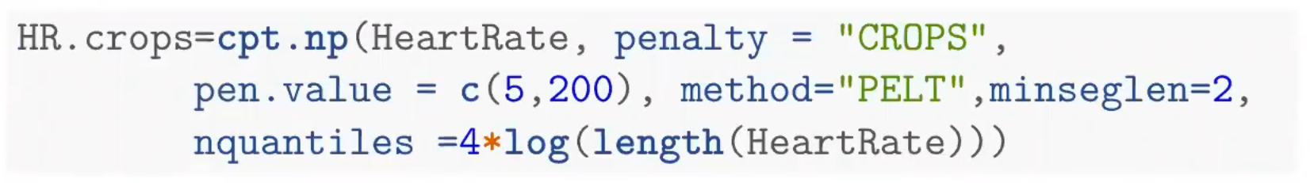
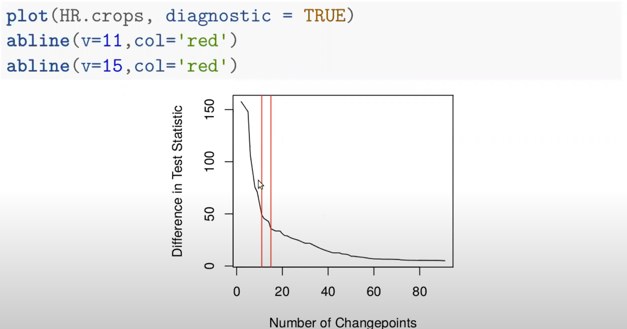
Task: HeartRate

Slide 41
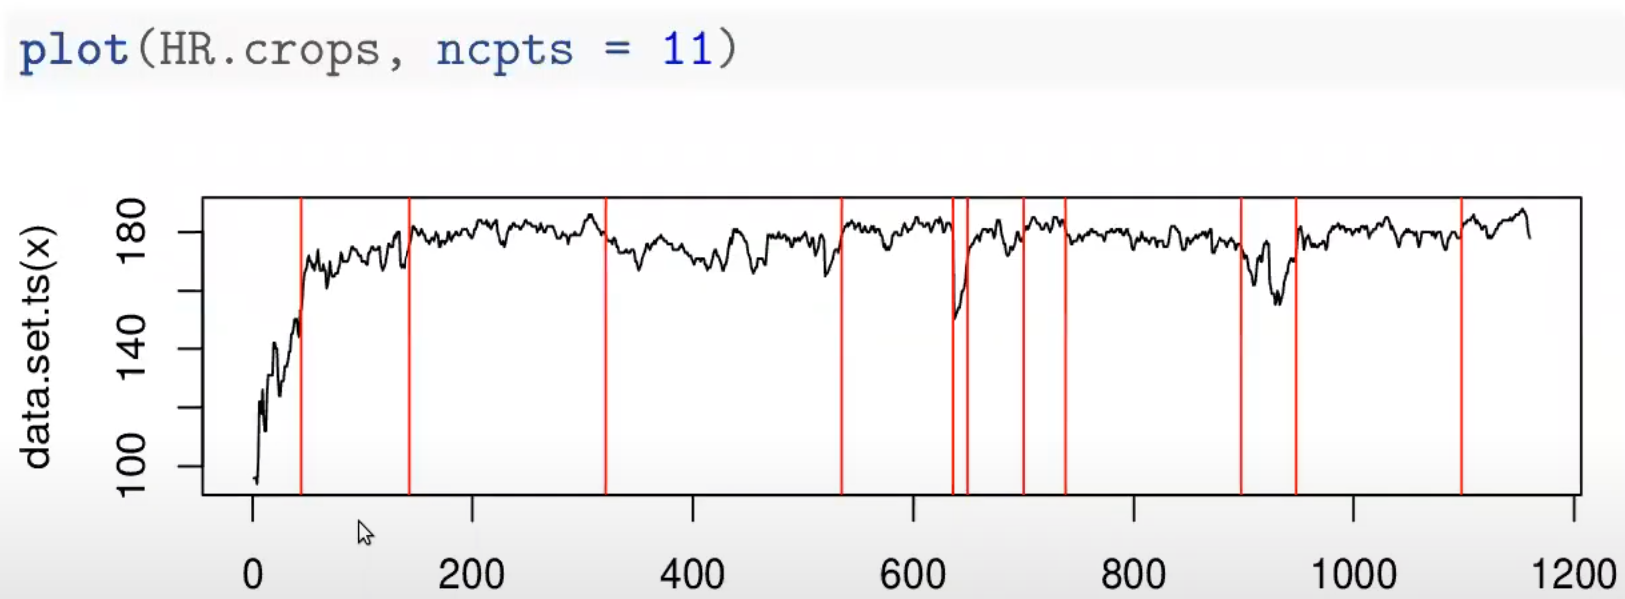
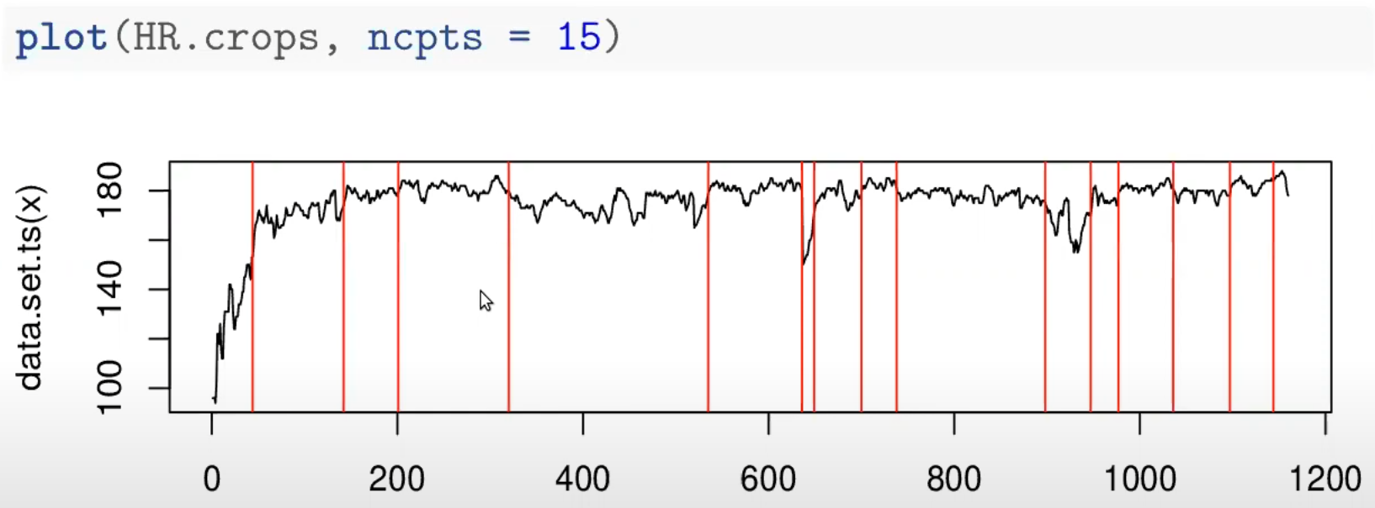
Task: HeartRate

Slide 42
Checking Assumptions
The main assumptions for a Normal likelihood ratio test for a change in mean are:
Independent data points;
Normal distributed points pre and post change;
Constant variance across the data.
How can we check these?

Slide 43
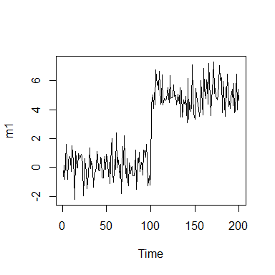
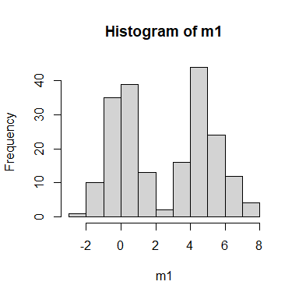
Checking Assumptions
In reality we can’t check assumptions prior to analysis.
ts.plot(m1)
## Checking Assumptions
hist(m1)
shapiro.test(m1)
## ## Shapiro-Wilk normality test ## ## data: m1 ## W = 0.91086, p-value = 1.31e-09
ks.test(m1,pnorm,mean=mean(m1),sd=sd(m1))
## ## One-sample Kolmogorov-Smirnov test ## ## data: m1 ## D = 0.15491, p-value = 0.0001355 ## alternative hypothesis: two-sided

Slide 44
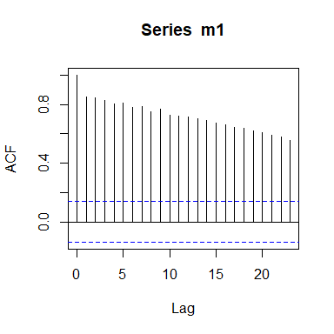
Checking Assumptions
acf(m1)

Slide 45
How to check
Check the residuals
means=param.est(m1.amoc)$mean m1.resid=m1-rep(means,seg.len(m1.amoc)) shapiro.test(m1.resid)
## ## Shapiro-Wilk normality test ## ## data: m1.resid ## W = 0.99228, p-value = 0.3721

Slide 46
Residual Check
ks.test(m1.resid,pnorm,mean=mean(m1.resid),sd=sd(m1.resid))
## ## One-sample Kolmogorov-Smirnov test ## ## data: m1.resid ## D = 0.045812, p-value = 0.7953 ## alternative hypothesis: two-sided

Slide 47
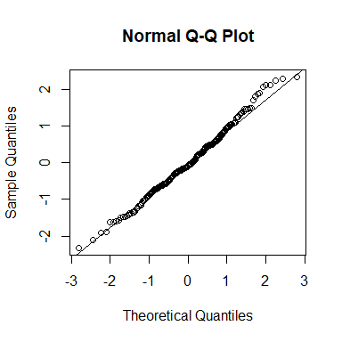
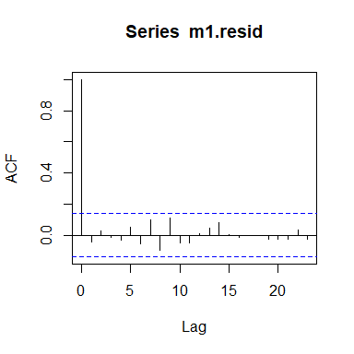
Residual Check
qqnorm(m1.resid) qqline(m1.resid)
acf(m1.resid)

Slide 48
Task
Check the assumptions you have made on the simulated, , GP Appointments, HC1 and HeartRate data using the residual check.
What effect might any invalid assumptions have on the inference?

Slide 49
Summary
Use cpt.mean and cpt.var only if you know what you are doing
If the stationary distribution can be approximated by Normal, Gamma, Exponential, Poisson distribution use cpt.meanvar otherwise use cpt.np
Need number of points: go with PELT and MBIC for penalty or PELT with CROPS and use “elbow” method to identify number of change points.

Slide 50
References
JSS: Killick, Eckley (2014) PELT: Killick, Fearnhead, Eckley (2012) CROPS: Kaynes, Eckley, Fearnhead (2015) cpt.np: Haynes, Fearnhead, Eckley (2016)

